Slide 1
IMPLEMENTING TEXTMESSAGE CONCEALMENT THROUGH DIGITALWATERMARKING
By
Rancheni SR
(312420104128)
Sushmitha CN
(312420104167)

Slide 2
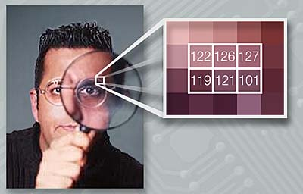
INTRODUCTION
01

Slide 3
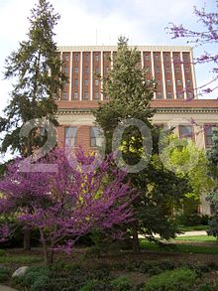
What is Watermarking?
Digital Watermarking is use of a kind of marker convert embedded in a digital media such as audio, video or image which enables us to know the source or owner of the copyright. This technique is used for tracing copyright infringement in social media and knowing the genuineness of the notes in the banking system.

Slide 4
Types of Watermarks
Visible Watermarks
Invisible Watermarks
Public Watermarks
Fragile Watermarks

Slide 5
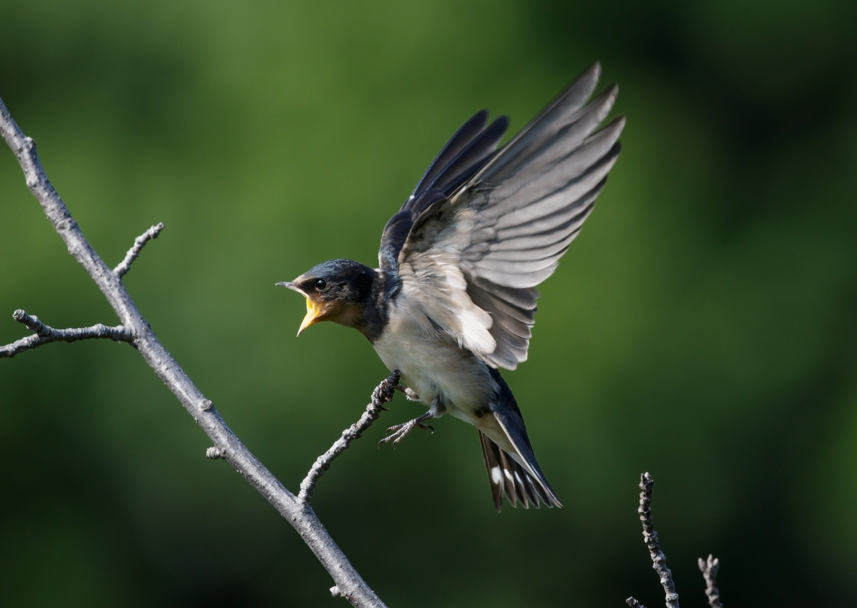
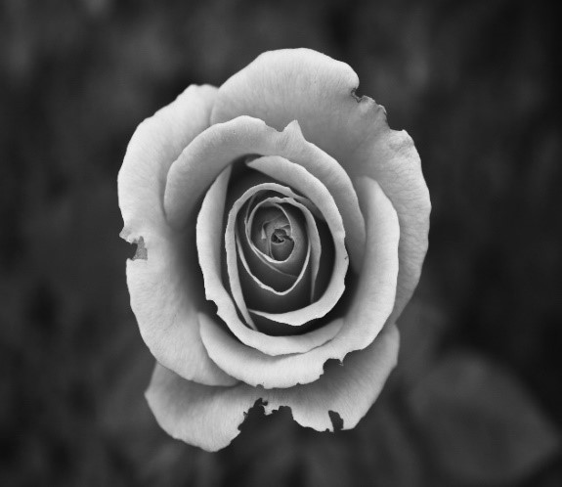
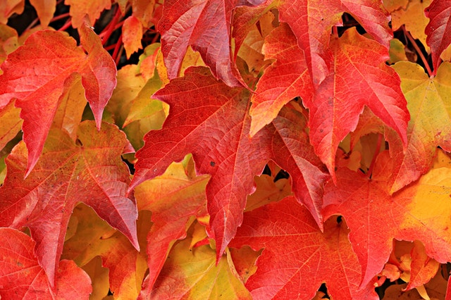
Literature Review
Steganography
Discrete Cosine Transform
AES – 128 Encryption System

Slide 6
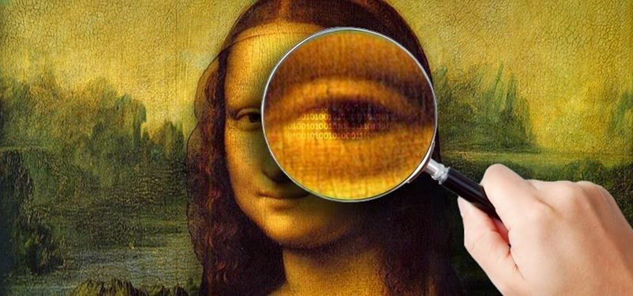
What is Image Steganography?
Image Steganography is the process of hiding information which can be text, image or video inside a cover image. The secret information is hidden in a way that it not visible to the human eyes. The image selected for this purpose is called the cover image and the image obtained after steganography is called the stego image.

Slide 7
Approaches Used For Image Steganography
Spatial Domain Technique
Masking and Filtering
Transforma-tion Techniques

Slide 8
About Discrete Cosine Transform (DCT)
The discrete cosine transform (DCT) is a transformation method that separates the image into parts (or spectral sub-bands) of differing importance (with respect to the image's visual quality).
Similar to the discrete Fourier transform: it transforms a signal or image from the spatial domain to the frequency domain.
Widely used transformation technique in signal processing, image processing and by far the most widely used linear transform in data compression.

Slide 9
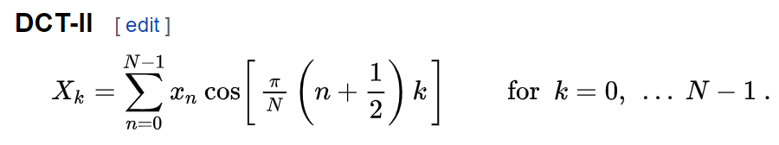
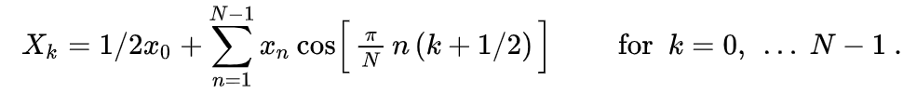
Formulae
DCT - II
DCT – III or IDCT

Slide 10
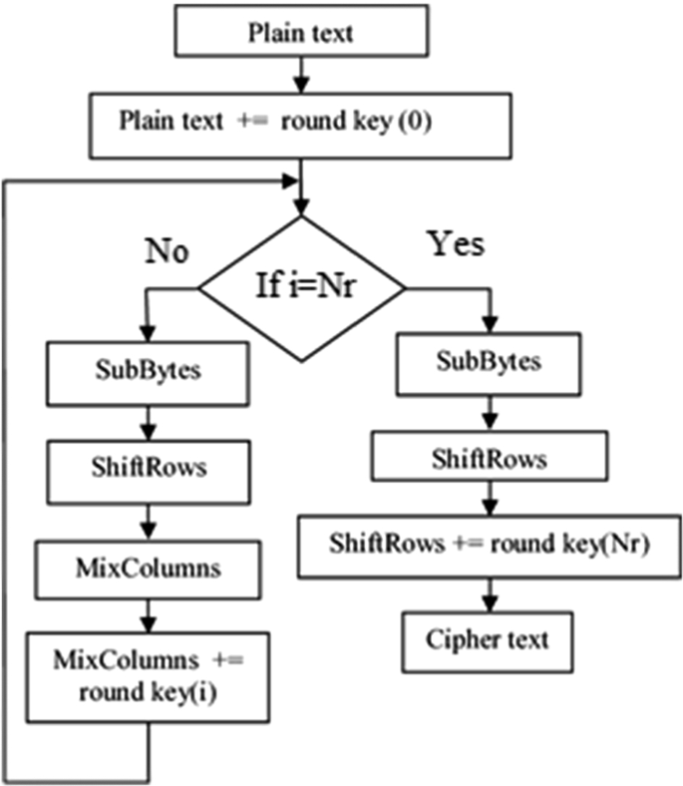
About AES Encryption System
The Advanced Encryption Standard (AES) is a symmetric block cipher chosen by the U.S. government to protect classified information.
AES is implemented in software and hardware throughout the world to encrypt sensitive data.
Variant of Rijndael, with a fixed block size of 128 bits, and a key size of 128, 192, or 256 bits.
This Photo by Unknown Author is licensed under CC BY

Slide 11

Project Objective

Slide 12
This project aims to build a simplified model for hiding text messages within the image using two most commonly used DCT Transformation techniques that is DCT-2 and IDCT and AES encryption system for security enhancement in image encryption.

Slide 13
Python Libraries Used
numpy
tkinter
opencv
pycrypto
pillow

Slide 14
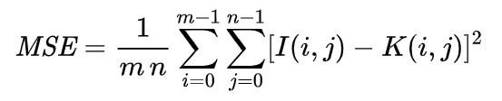
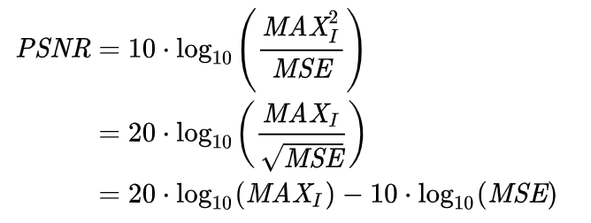
About PSNR (Peak Signal Noise Ratio)
PSNR is most easily defined via the mean squared error (MSE). Given a noise-free m×n monochrome image I and its noisy approximation K, MSE is defined as:
The PSNR (in dB) is defined as:
Here, MAXI is the maximum possible pixel value of the image. When the pixels are represented using 8 bits per sample, this is 255. More generally, when samples are represented using linear PCM with B bits per sample, MAXI is 2B−1.

Slide 15
Literature Survey :
SI.no | Paper Name | Publisher | Year | Key point
1. | "Enhancing the Security and Quality of LSB Based Image Steganography" | Akhtar, N.; Johri, P.; Khan, S., | 2011 | The paper by Akhtar et al. focuses on enhancing the security and quality of LSB (Least Significant Bit) based image steganography. They propose a new method of steganography that involves dividing the image into smaller blocks and then using LSB and DCT (Discrete Cosine Transform) methods to embed the secret message. The proposed method provides better security and higher quality stego-images compared to existing methods.

Slide 16
SI.NO | Paper Name | Publisher | Year | Key Points
2. | "Steganalysis of LSB matching in grayscale images." | Andrew D. Ker | 2010 | The paper by Andrew D. Ker is focused on steganalysis, which is the process of detecting the presence of hidden information in digital media, specifically in grayscale images.
3. | "Rotation, Complement and Mirroring Invariant Texture Patterns for Binary Image Steganography," | Bingwen Feng, Jianwei Liu, Xuan Kong, and Zhangjie Fu | 2015 | The paper by Feng et al. is focused on binary image steganography, which involves hiding secret information in binary images.
4. | "A Novel Steganographic Method by Pixel-Value Modification," | C.-C. Chang, C.-S. Tsai, and T.-S. Chen | 2007 | The paper by Chang et al. proposes a novel method for steganography, which involves modifying the pixel values of an image to embed secret information.

Slide 17
SI.NO | Paper Name | Publisher | Year | Key Points
5. | "A differencing steganographic method with a range table and no distortion compensation" | Da-Chun Wu, Ming-Shing Hsieh, Chin-Feng Lee, and Ya-Fen Chang | 2013 | The paper by Wu et al. proposes a new differencing steganographic method, which involves using a range table and no distortion compensation to embed secret information in digital images.
6. | "A novel approach for image steganography using Huffman encoding technique" | R. Das, S. Sarkar, and S. Nandi | 2012 | The paper by Das et al. proposes a new approach for image steganography, which involves using the Huffman encoding technique to embed secret information in digital images.
7. | "A novel DWT based image securing method using steganography" | Della Baby, P. V. Sridevi, and K. Rajesh | 2015 | The paper by Baby et al. proposes a new image securing method using steganography, based on the discrete wavelet transform (DWT) technique.

Slide 18
SI.NO | Paper Name | Publisher | Year | Key Points
8. | A novel approach for color image steganography based on X-box mapping | Dagar, E., & Dagar, S. | 2013 | The paper proposes a new approach for color image steganography based on X-box mapping. X-box mapping is a technique that maps a pixel in an image to a unique value in the range [0, 1] using a mathematical formula.
9. | "A survey on recent achievements of LSB based image steganography" | G. Prashanti, N. Sudhakar, and P. Rajesh Kumar | 2015 | The paper provides a comprehensive survey of recent achievements in LSB-based image steganography, which is a widely used technique for hiding secret messages in digital images.
10. | "A secure image steganography technique using Integer Wavelet Transform," | Hemalatha, S.; Acharya, U.D.; Renuka, A.; Kamath, P.R., | 2012 | The paper proposes a secure image steganography technique that uses Integer Wavelet Transform (IWT) for embedding secret data in digital images.

Slide 19
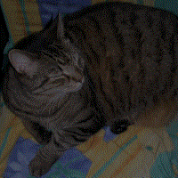


Framework and Algorithm

Slide 20
Hiding
Message
Source image
Text Message
AES Encryption
DCT Transformation
Embedding
IDCT Transformation
Writing of Stereography
Stereo Image

Slide 21
Displaying Message
Source image
DCT Transformation
Extraction
AES Decryption
Text Message

Slide 22
Algorithm For Gray Scale Images
Embedding
Encrypt the message using AES encryption system.
Take the image and divide the image into 8X8 blocks and subtracting with 128.
Apply DCT to each block and round it off.
Embed the message in each LSB of DCT coefficients.
Apply inverse DCT to each block and add each block by 128 and stich back the image in lossless image format (e.g., .png format).
Extraction
Take the stereo image and divide the image into 8X8 blocks and subtracting with 128.
Apply DCT to each block and round it off.
Extract the message from each LSB of DCT coefficients.
Decrypt the message using AES encryption system.

Slide 23
Algorithm For RGB Images
Embedding
Encrypt the message using AES encryption system.
Take the image and split it into three channels that is Red , Green and Blue.
Take the green channel and divide the image into 8X8 blocks and subtracting with 128.
Apply DCT to each block and round it off.
Embed the message in each LSB of DCT coefficients.
Apply inverse DCT to each block and add each block by 128 and stich back the image in lossless image format (e.g., .png format).
Extraction
Take the stereo image and Take the image and split it into three channels that is Red , Green and Blue.
Take green channel and the divide the image into 8X8 blocks and subtracting with 128.
Apply DCT to each block and round it off.
Extract the message from each LSB of DCT coefficients.
Decrypt the message using AES encryption system.

Slide 24

Results

Slide 25
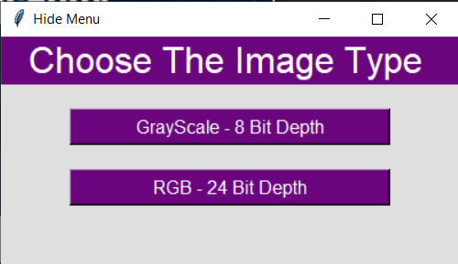
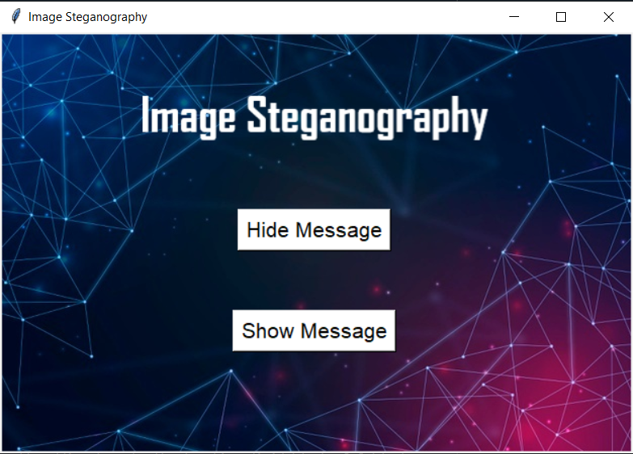
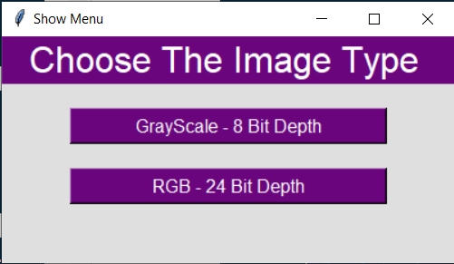
Screen Shots of User Interface

Slide 26
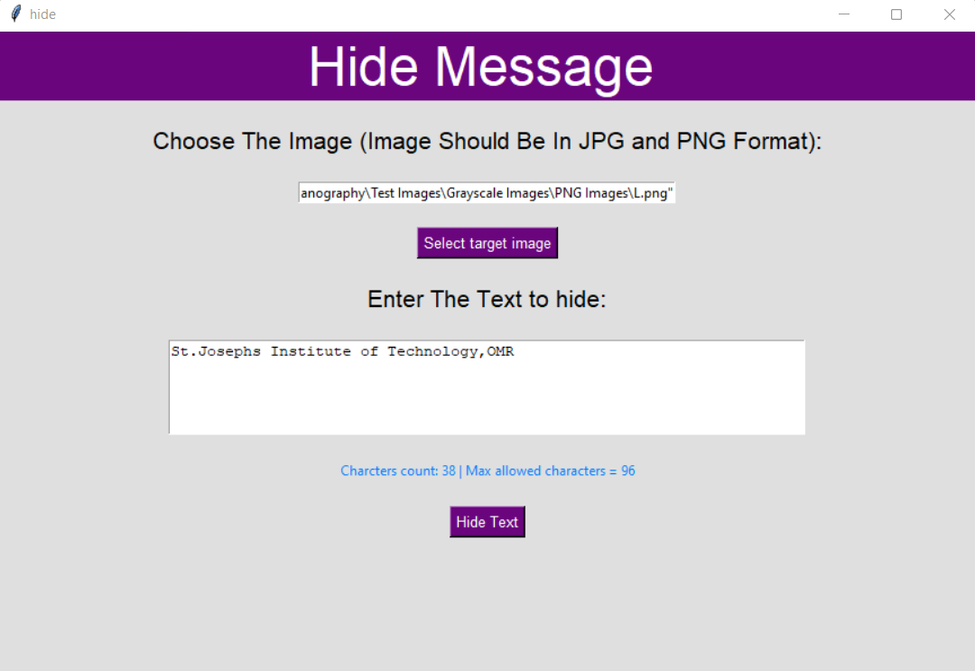
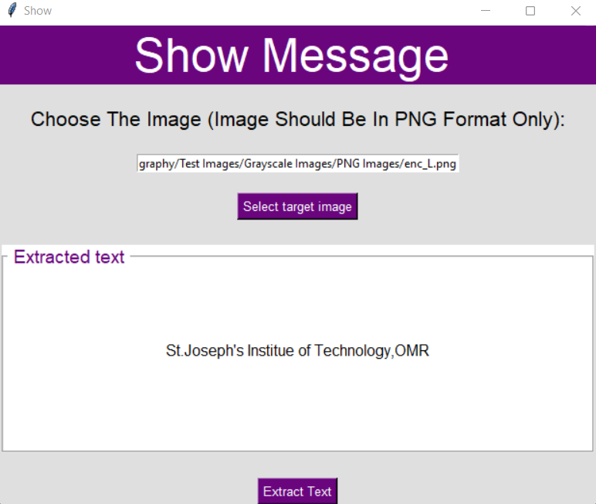

Slide 27

Output
Before
Apple1.png
After
enc_Apple1.png
PSNR is 50.96696736785725

Slide 28

Output
Before
JG.png
After
enc_JG.png
PSNR is 41.44866206319571

Slide 29

Conclusion

Slide 30
Since the proposed technique is more secure than spartial technique, but it has some disadvantages. Firstly, it AES – 128 is not much secure in nature. Secondly, ECB mode used in AES -128 is least secure. Lastly, however dct is computationally fast stores images with less distortion but some of the messages cannot be extracted properly due to the increase in the noise level above 0.32bpp. DCT also does not provide proper robostness to geometric attacks. To overcome the disadvantages, one can use DWT and DFT instead of DCT or they can use Genetic algorithms and Lossless Image Compression techniques for solving message extraction problem and one can use AES-256 with more secure modes such as CBC and EAX for enhancing the security. Researchers are still figuring out many ways for finding out highly secure image steganography methods.

Slide 31
REFERENCES
[1]. Akhtar, N.; Johri, P.; Khan, S., "Enhancing the Security and Quality of LSB Based Image Steganography," Computational Intelligence and Communication Networks (CICN), 2013 5th International Conference on , vol., no., pp.385,390, 27-29 Sept. 2013. based image Steganography," Recent Trends in Information Systems (ReTIS), 2011 International Conference on , vol., no., pp.214,217, 21-23 Dec. 2011.
[2]. Andrew D. Ker (2010). "Steganalysis of LSB matching in grayscale images." Proceedings of the 2010 2nd International Conference on Signal Processing Systems (ICSPS), pp. V2-334-V2-337
[3]. Bingwen Feng, Jianwei Liu, Xuan Kong, and Zhangjie Fu (2015). "Rotation, Complement and Mirroring Invariant Texture Patterns for Binary Image Steganography," Information Sciences, vol. 300, pp. 19-33.
[4]. C.-C. Chang, C.-S. Tsai, and T.-S. Chen (2007). "A Novel Steganographic Method by Pixel-Value Modification," Proceedings of the IEEE International Conference on Multimedia and Expo (ICME), pp. 2038-2041.

Slide 32
[5]. Da-Chun Wu, Ming-Shing Hsieh, Chin-Feng Lee, and Ya-Fen Chang (2013). "A differencing steganographic method with a range table and no distortion compensation," Journal of Visual Communication and Image Representation, vol. 24, pp. 792-800.
[6]. R. Das, S. Sarkar, and S. Nandi (2012). "A novel approach for image steganography using Huffman encoding technique," International Journal of Computer Applications, vol. 55, no. 16, pp. 29-34.
[7]. Della Baby, P. V. Sridevi, and K. Rajesh (2015). "A novel DWT based image securing method using steganography," International Journal of Advanced Research in Computer Science and Software Engineering, vol. 5, no. 9, pp. 858-864.
[8]. Dagar, E., & Dagar, S. (2013). A novel approach for color image steganography based on X-box mapping. International Journal of Advanced Research in Computer Science, 4(5), 213-216.
[9]. G. Prashanti, N. Sudhakar, and P. Rajesh Kumar, "A survey on recent achievements of LSB based image steganography," International Journal of Advanced Research in Computer Science and Software Engineering, vol. 5, no. 8, pp. 764-769, 2015.

Slide 33
[10]. Hemalatha, S.; Acharya, U.D.; Renuka, A.; Kamath, P.R., "A secure image steganography technique using Integer Wavelet Transform," Information and Communication Technologies (WICT), 2012 World Congress on , vol., no., pp.755,758, Oct. 30 2012-Nov. 2 2012.
[11]. Huaiqing Wang, Qingzhong Liu, Zhenxing Qian, and Jingjing Liu. (2014). A survey on steganography and steganalysis. Journal of Information Hiding and Multimedia Signal Processing, 5(3), 443-452.
[12]. Jessica Fridrich, Miroslav Goljan, Dorin Hogea, "Estimation of secret message length in LSB steganography in spatial domain", Proceedings of the 2012 IEEE International Workshop on Information Forensics and Security (WIFS), 2012, pp. 59-64.
[13]. Johnson, N. F., Jajodia, S., & Stavrou, A. (2002). Exploring steganography: seeing the unseen. IEEE computer graphics and applications, 22(4), 26-34.
[14]. Qazanfari, K., Mohammadi, M., & Boroumand, L. (2014). A novel improved LSB++ approach for image steganography. Journal of Electronic Imaging, 23(1), 013024. doi: 10.1117/1.JEI.23.1.013024

Slide 34
THANKS
By: Rancheni SR
&
Sushmitha CN

